Slide 1
Finding an Optimal Restaurant Location and Cuisine Preference for Visitors in Birmingham, UK
IBM Data Science – Capstone Project
K PATEL
February 2021

Slide 2
AGENDA
Introduction
Data
Results & Analysis
Conclusions

Slide 3
INTRODUCTION
Birmingham is a large city many visitors per year for business or leisure
High potential for investors in restaurant sector.
where would the optimal location to open a new restaurant in the city centre?
Which type of cuisine is most popular and can it be a factor in where to locate the new restaurant?

Slide 4
DATA
Foursquare API utilized as a source of data.
Two datasets retrieved, cleaned, and prepared for analysis.
→ Hotels
→ restaurants

Slide 5
RESULTS & ANALYSIS

Slide 6
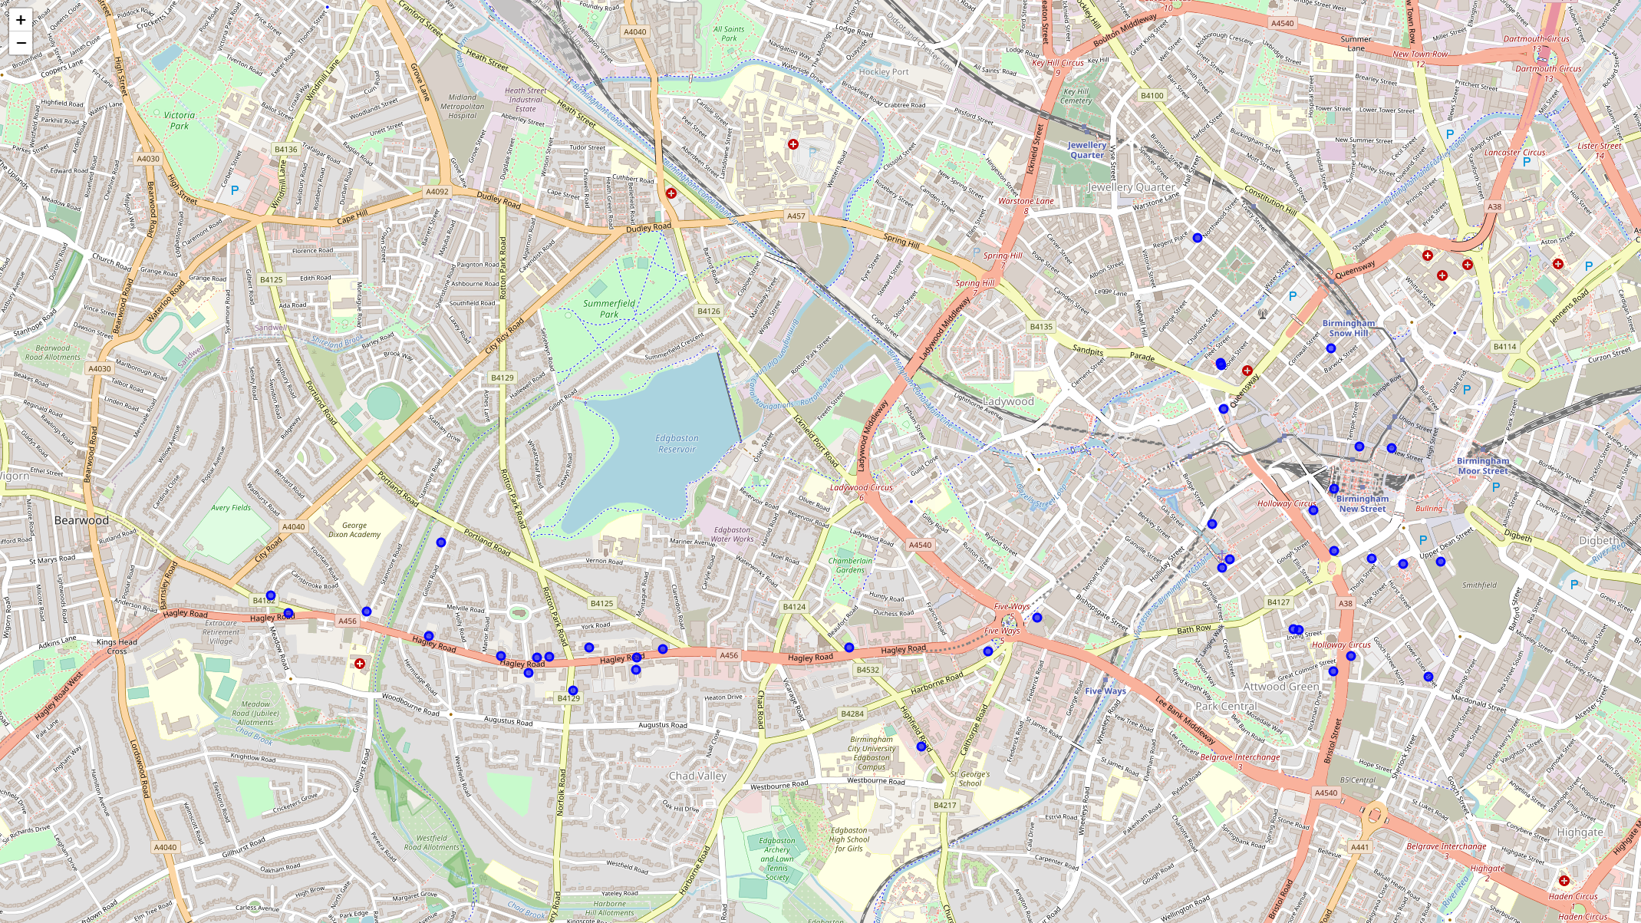
HOTELS LOCATIONS
hotel data visualized on a map view
grouping of hotels in clusters required to identify areas of high proportion of visitors to Birmingham
From visual inspection, 3 clusters can be inferred

Slide 7
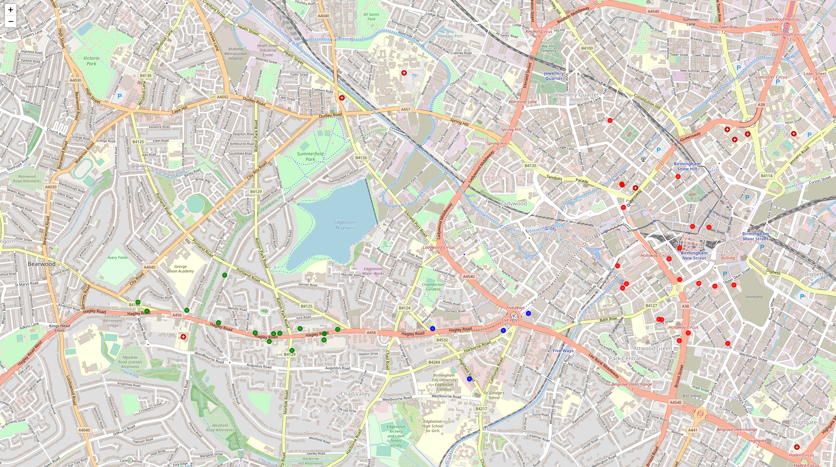
HOTELS CLUSTERING
K-Means Clustering algorithm used to group hotels in three clusters
Red-green-blue coloring scheme used to differentiate hotels of different clusters

Slide 8
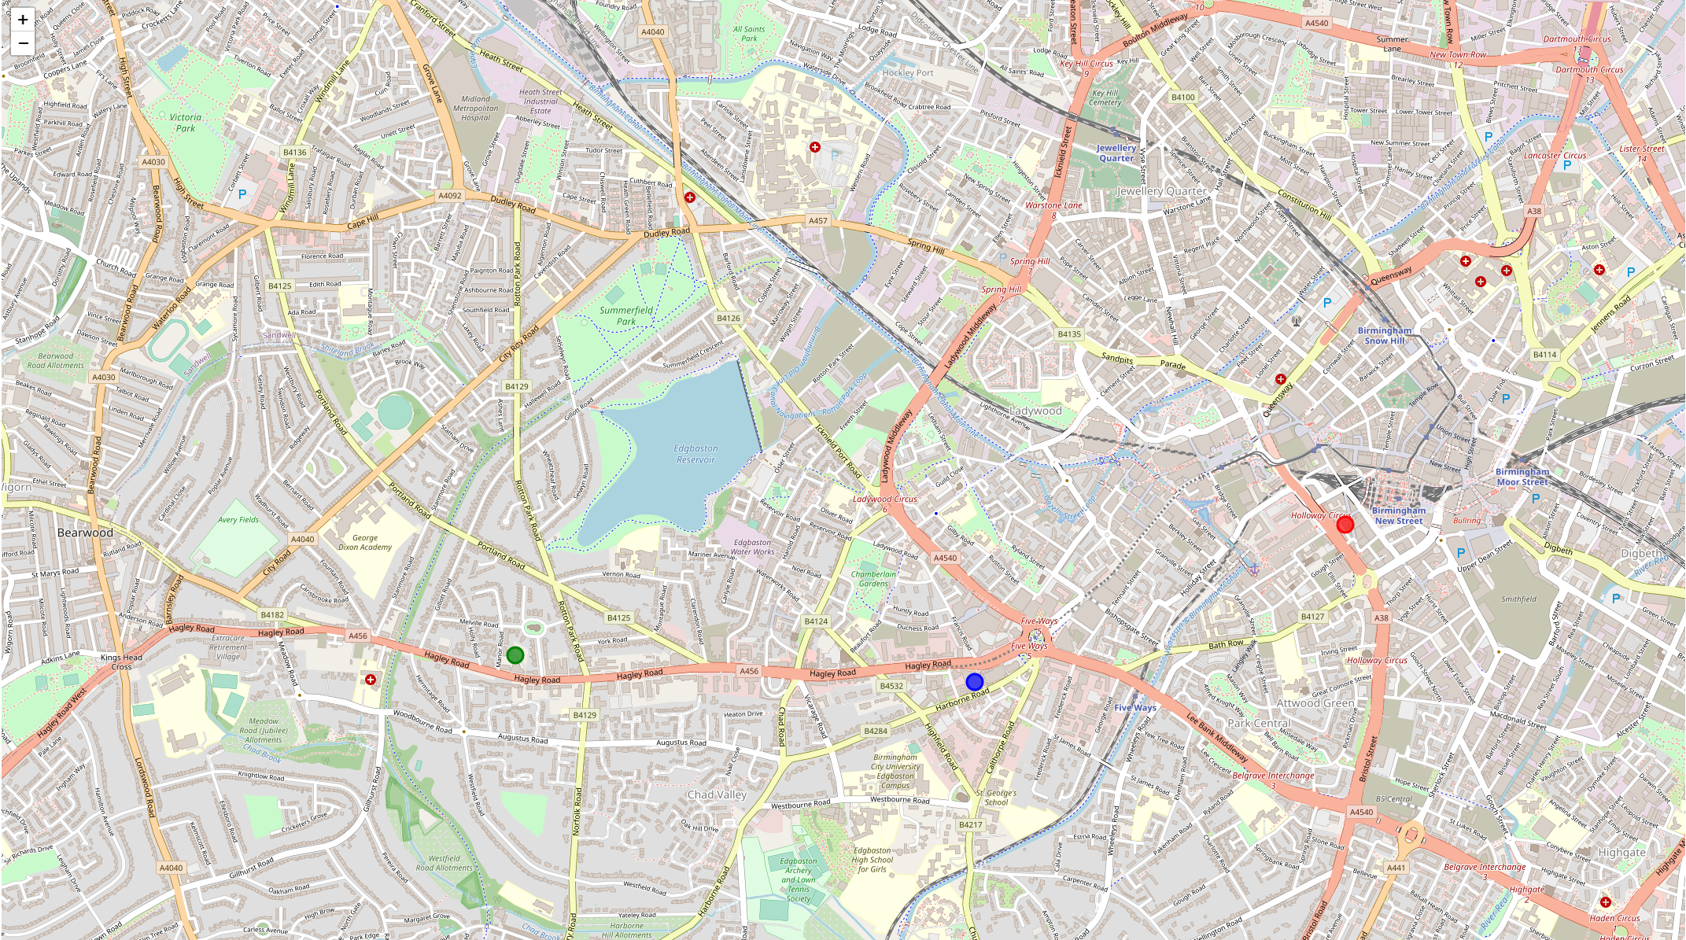
HOTELS CLUSTERING - CENTERS
Each cluster generated by K-Means
hotels centered around a single point
points location coordinates retrieved and visualized

Slide 9
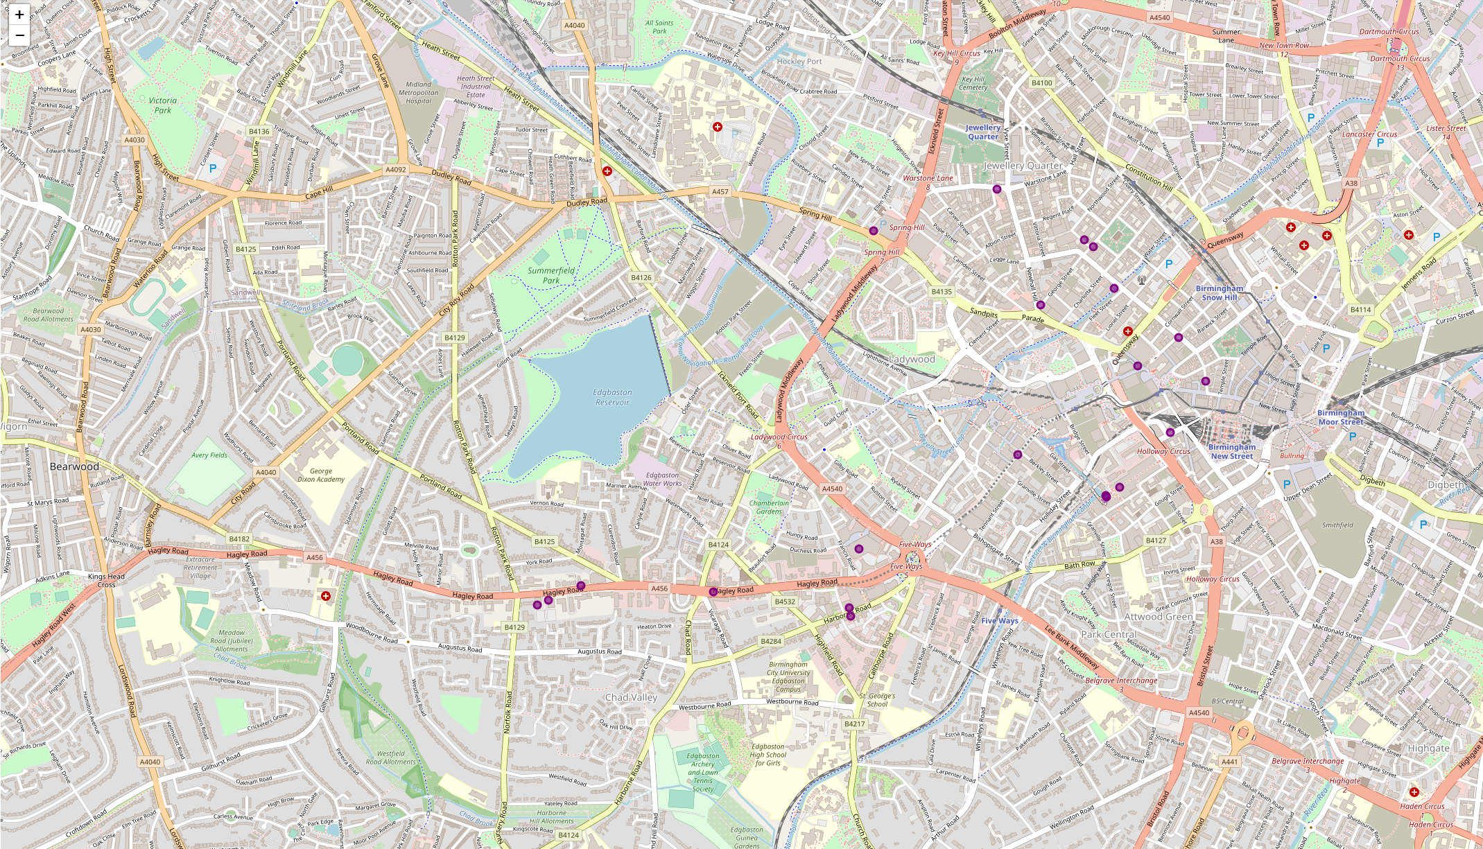
RESTAURANT LOCATIONS
Restaurants locations retrieved from Foursquare API
Required to classify the restaurants according to hotel clusters (next slide)

Slide 10
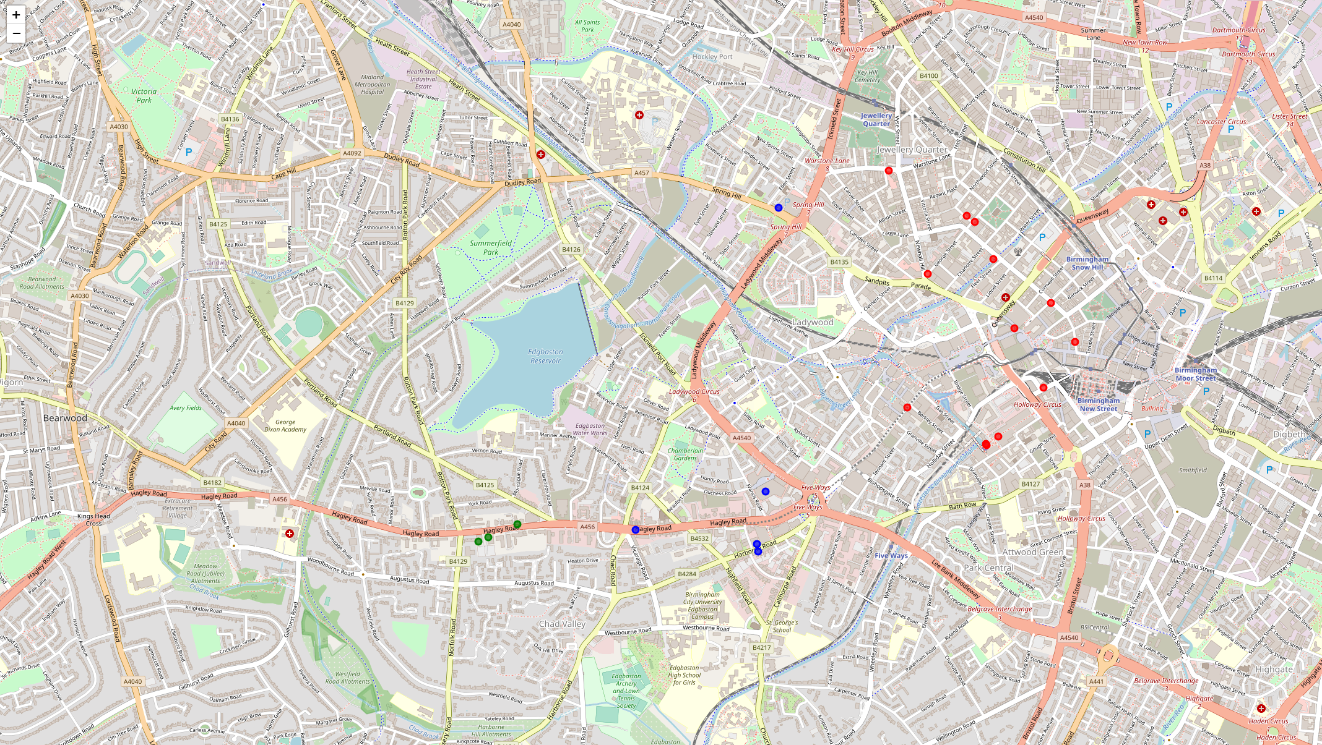
RESTAURANT LOCATIONS – BY CLUSTER
KNN Classification algorithm used to assign a class label to each restaurant
KNN model trained on the center locations dataset
Each restaurant assigned the value of the closest single center

Slide 11
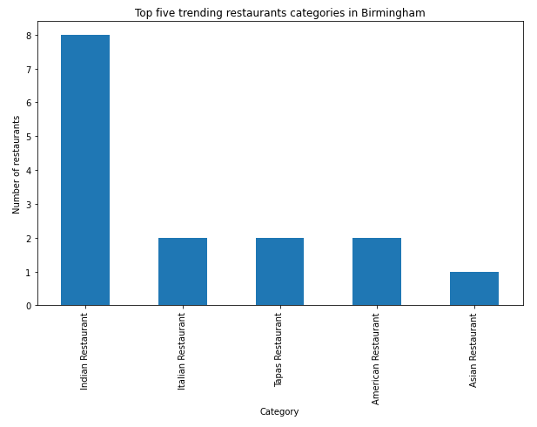
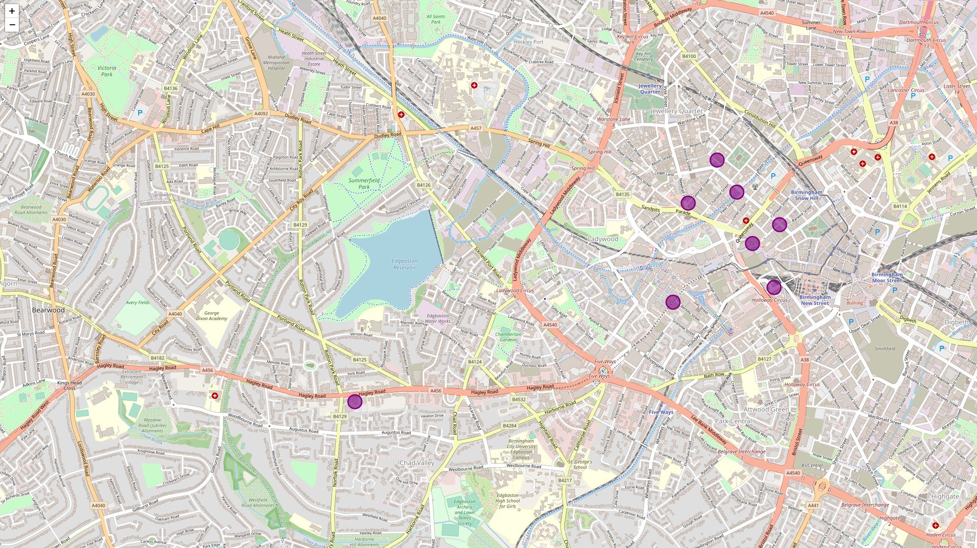
POPULAR CUISINE TYPES
ONLY 1 INDIAN RESTAURANT IN LEFT CLUSTER
NO INDIAN RESTAURANT IN CENTRAL CLUSTER
HIGH DENSITY OF INDIAN RESTAURANTS IN RIGHT CLUSTER (7)
frequency of each cuisine type calculated → top 5 plotted
indian cuisine by far the most popular in birmingham

Slide 12
CONCLUSIONS
hotels and restaurants information retrieved from foursquare api.
hotel data successfully analyzed using k-means clustering algorithm.
→ grouped in three clusters
restaurants’ data used as target dataset for knn classification algorithm.
visualize scatter of restaurants according to cluster
cluster 1 (green) favourable for new restaurant location.
fewer restaurants compared to clusters 0 & 2
second highest number of hotels
indian food most popular cuisine type.
no indian restaurants in cluster 2, could be an alternative investment opportunity

